Slide 1



DEPARTMENT OF ELECTRONICS AND COMMUNICATION ENGINEERING
18ECP105L - MINOR PROJECT REVIEW

Slide 2
AIR QUALITY MONITORING SYSTEM USING ARDUINO
PRESENTED BY: ABINAYA T (927621BEC005) DHANUSRI R P (927621BEC035) DHARSHINIPRIYA R (927621BEC044) GANISKA S (927621BEC052)
GUIDED BY: Mr.S.ARUNPRATHAP Assistant professor / ECE

Slide 3
LIST OF CONTENT
Objectives
Introduction
Problem identified
Literature Survey
Existing System
Proposed System
Block diagram
Components
Work Status
Application
Conclusion
Reference

Slide 4
OBJECTIVES
Measuring Air Quality is an important element for bringing lot of awareness in the people to take care of the future generations a healthier life.
Based on this, Government of India has already taken certain measures to ban Single Stroke and Two Stroke Engine based motorcycles which are emitting high pollutions comparatively.
Also, we have reduced the cost of components used on comparing with the papers referred.
This system will continuously monitor the gases available in a closed environment and saves your life from harmful diseases.

Slide 5
INTRODUCTION
In recent years the Air Pollution levels are increasing throughout the globe.
Now these pollutions are reached a level where even indoors and outdoors are causing the sudden asthma, wheezing etc..,
Factors causing air pollution are the increase in usage of fossil fuels, industries, vehicle emissions which affects the human health also.
In order to overcome it our project will monitor the air quality in real time and check the air quality to get the purified air.

Slide 6
PROBLEM STATEMENT
Already, New Delhi is remarked as the most pollution city in the world recording Air Quality above 300PPM.
We have corrected the other papers where they have wrongly calibrated the sensor and wrongly projecting the PPM values.
If the quality of the air is getting poor, our system will give an alert signal. That will helps to prevent the employees from accidents.
If we install this system in industries it will ensures the safety of the employees as well as equipment's or machinery used in the factory.

Slide 7
Literature Survey
The drawback of WIFI- enabled indoor air quality monitoring and control system the current work focuses on the control of the particulate matter PM 2.5 concentration.
This technology is more expensive. An embedded system model for Air Quality Monitoring is drawback of present National air quality monitoring network is limited in scope as the recorded values are indicative and there is immense time lag in reporting the data.
So real time action is not possible.

Slide 8
EXISTING SYSTEM
Air quality sensors are installed in the targeted area on top of buildings, industrial areas, traffic and residential areas.
These sensors are connected to a microcontroller to control the sensors network.
The data collected by the microcontroller is transmitted to the cloud for analysis.

Slide 9
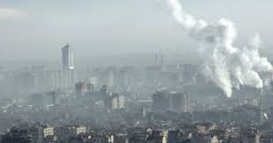
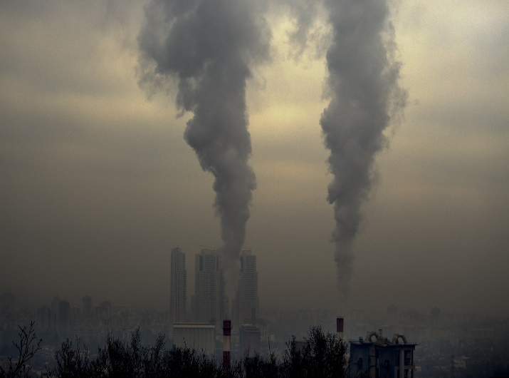
PROPOSED SYSTEM
The components cost is reduced compared to the existing system.
The ppm level approximately equal to actual level.
Compact to use.

Slide 10
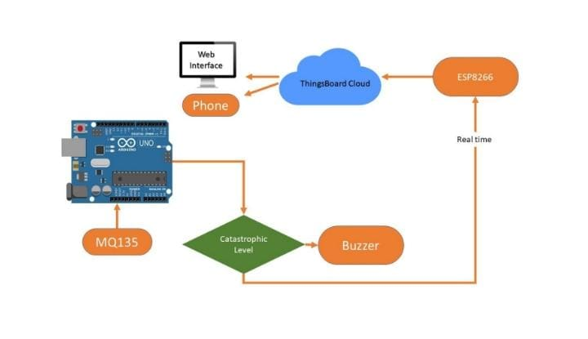
BLOCK DIAGRAM

Slide 11
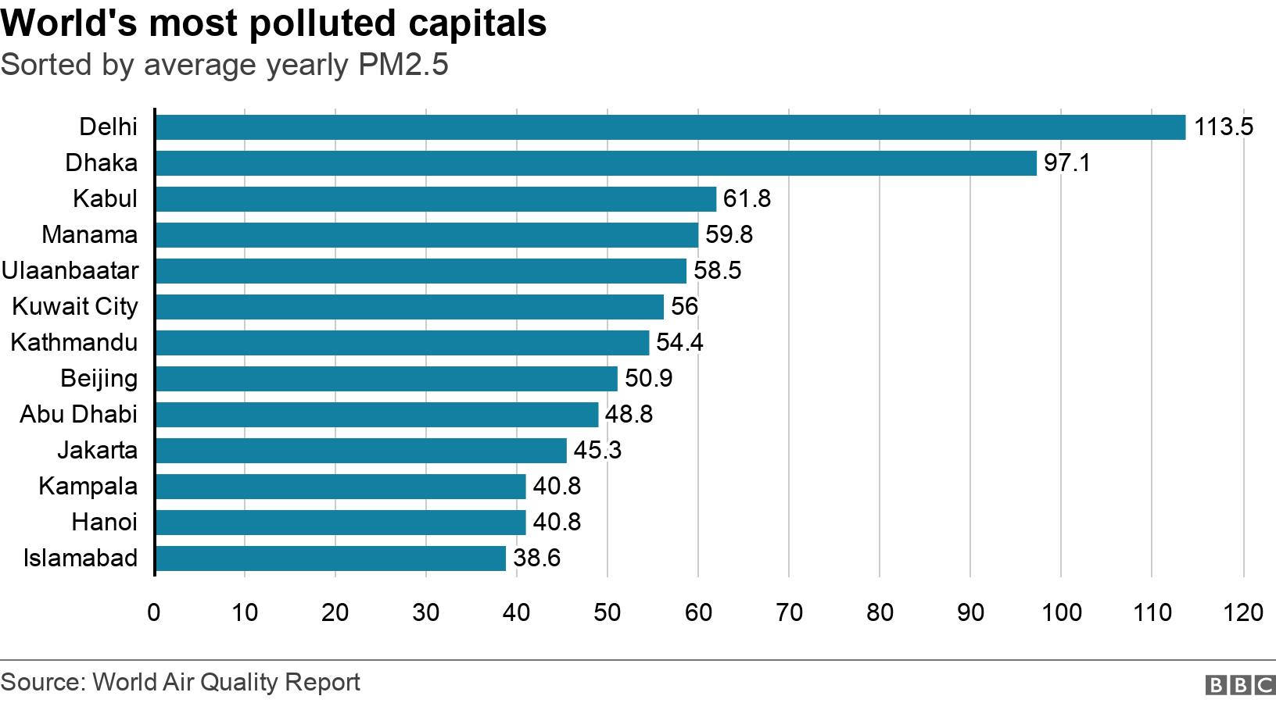
COMPONENTS
Arduino
MQ 135 sensor
LCD display
Buzzer

Slide 12
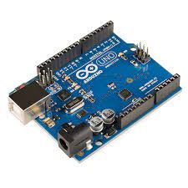
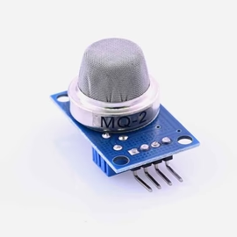
Arduino
Arduino is an open source, allows users a simple pathway to creating interactive objects that can take input from switches and sensors, and control physical outputs like lights, motors, or actuators.
MQ 135 sensor
This sensor can detect gases like Ammonia , sulfur , Benzene, Carbon-dioxide and other harmful gases and smoke. This module operates at 5V, has 33Ω±5% resistance, and consumes around 150mA.

Slide 13
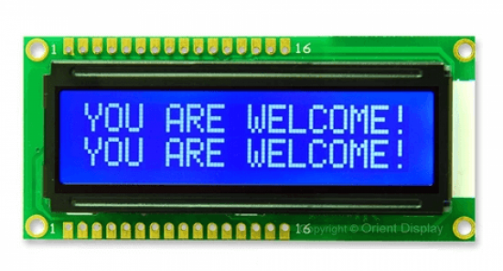
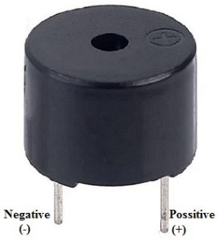
LCD display Air level can be monitored using MQ135 air quality sensor , LCD is used to display the quality of air in ppm. Buzzer It will alarm when the air quality level get worse compared to normal level

Slide 14
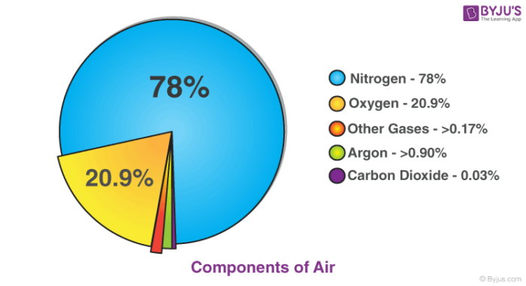
Work status
It’s almost the stage of completion around 84%.
The circuit has successfully done but the prototype is not organised.
The real time experience will done as soon as possible.

Slide 15
APPLICATIONS
Used in industries to monitor the concentration of toxic gases.
Used in households to detect an emergency incidents.
Used to check the ppm of the air to save you from the lung disease.

Slide 16
CONCLUSION
Air quality monitoring system which will reduce the initial cost installation.
Most of industries use it, because it work fatly to protect and most effective .
In future the use of gas and smoke detection will increases .

Slide 17
REFERENCE
Databases from PubMed, IEEE Xplore, Google Scholar, and other academic search engines.
To find relevant research papers and publications in the field of air quality monitoring.

Slide 18

THANK YOU!

